Slide 1
Content Monetization Modeler
(Regression models)

Slide 2
Summary:
In today’s digital era, platforms like YouTube serve as a major source of income for individual creators and media companies. However, predicting ad revenue remains a challenging task due to the large number of influencing factors such as views, likes, comments, watch time, content type, and audience demographics.
This project, Content Monetization Modeler, aims to develop a regression-based predictive system to estimate YouTube ad revenue using various performance and contextual features. By applying data preprocessing, feature engineering, and regression modeling, the project not only delivers accurate predictions but also provides insights into the factors that drive monetization success.
Additionally, the model is integrated into a Streamlit web application, enabling creators, advertisers, and media analysts to interactively test the model, visualize predictions, and derive meaningful insights for content strategy optimization, revenue forecasting, and ad campaign planning.
Objective:
The objective of this project is to build a regression-based predictive model that estimates YouTube ad revenue using video performance metrics, clean and preprocess the dataset, and deploy the results in a Streamlit web app for interactive predictions and insights.

Slide 3
Pipeline of the Project:
1.Data Understanding & Exploration
2.Data Preprocessing & Cleaning
3.Feature Engineering
4. Split Train & Test data
5.Model Building & Comparison
6.Model Evaluation
7.Streamlit dashboard
8.Business Insights

Slide 4
1.Data Understanding:
Knowing dataset’s shape, quality, meaning, and initial patterns before you clean and model it.
Having dataset with 12200 rows and 12 columns.
video_id---unique identifier.
Date--- Report date.
Views, likes, commands---important feature for revenue analysis.
watch_time_minutes -- Engagement and content length.
Subscribe, country, category, category--- Contextual info.
ad_revenue_usd--- Target variable(what we predict)
It helps to know our data before training a model, identify the data quality issues, choosing right preprocessing(scaling, encoding)

Slide 5
2.Data Cleaning:
Fixing problems in the dataset so it becomes ready for modeling. It improves accuracy, reliability, and quality of the results.
Remove unique columns --- video_id, date(don’t help in predicting revenue)
Handling missing values ---- likes(using median because likes don’t have a frequent (mode) value and the average (mean) can be misleading due to outliers so I use the median as a better mid-value, commends(using mode higher frequency ), watch_time_minute(using ffill because its time series).
Categorical Values Encoding --- category, country, device columns are filled in categorical value so using label encoding method it will be used for object into numerical value.
Remove Duplicate datas
Scaling numeric features --- Some columns have big numbers (like watch time in thousands) and some have small numbers, makes training easy and accurate.
Data cleaning importance is raw data often has missing values, duplicates, or errors, and if we don’t fix them the model will give wrong predictions, but with clean data the model learns better and gives more accurate results.

Slide 6
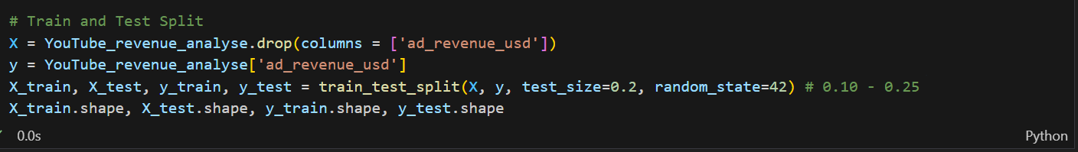
3. Feature Engineering:
Feature engineering means creating new useful features from the existing data to help the model learn better.
engagement rate feature = (likes + comments) / views, which gives more insight than using likes or comments alone.
4.Split Train & Test data:
Before building a model, we need to divide the dataset into two parts:
Training Set – Used to train the model and learn the relationship between features and target (ad revenue).
Testing Set – Used to evaluate the model on unseen data to check how well it predicts.
Typically, we use 80% of data for training and 20% for testing. This ensures the model can generalize and gives a realistic estimate of its performance.

Slide 7
5.Model Building & Comparison:
In this project, the goal is to predict YouTube ad revenue using regression techniques. To achieve this, five different regression models were built and trained on the dataset:
Linear Regression – A basic regression model that fits a straight line between input features and revenue.
Multiple Linear Regression – An extension of linear regression that uses multiple independent features together.
Ridge Regression – Adds a penalty to reduce overfitting and control large coefficients.
Lasso Regression – Similar to ridge but can shrink some coefficients to zero, which also helps in feature selection.
Elastic Net Regression – A combination of ridge and lasso penalties to balance between them.
Random Forest Regression - Random Forest Regression is an ensemble learning method that predicts a continuous target by averaging the outputs of multiple decision trees.
Gradient Boosting Regression - Gradient Boosting Regression is an ensemble technique that builds sequential decision trees, where each tree corrects the errors of the previous ones, to predict a continuous target variable.
Building multiple models and comparing them is important because not all models perform equally well on a dataset.

Slide 8
6.Model Evaluation:
R² Score (Coefficient of Determination):
R² measures how well the model explains the variation in the target variable.
Value range: 0 to 1 (or negative if very bad)
Higher is better --- closer to 1 means model explains most of the variation.
R2=1−∑i=1n​(yi​−yˉ​)2∑i=1n​(yi​−y^​i​)2​
MAE (Mean Absolute Error):
MAE is the average absolute difference between predicted and actual values.
Smaller values are better → closer to 0 means predictions are accurate.
MAE = n1​ i=1∑n​∣yi​−y^​i​∣
RMSE (Root Mean Squared Error):
RMSE is the square root of the average squared differences between predicted and actual values.
Sensitive to large errors because squaring magnifies bigger mistakes.
Smaller values are better → closer to 0 is ideal.

Slide 9
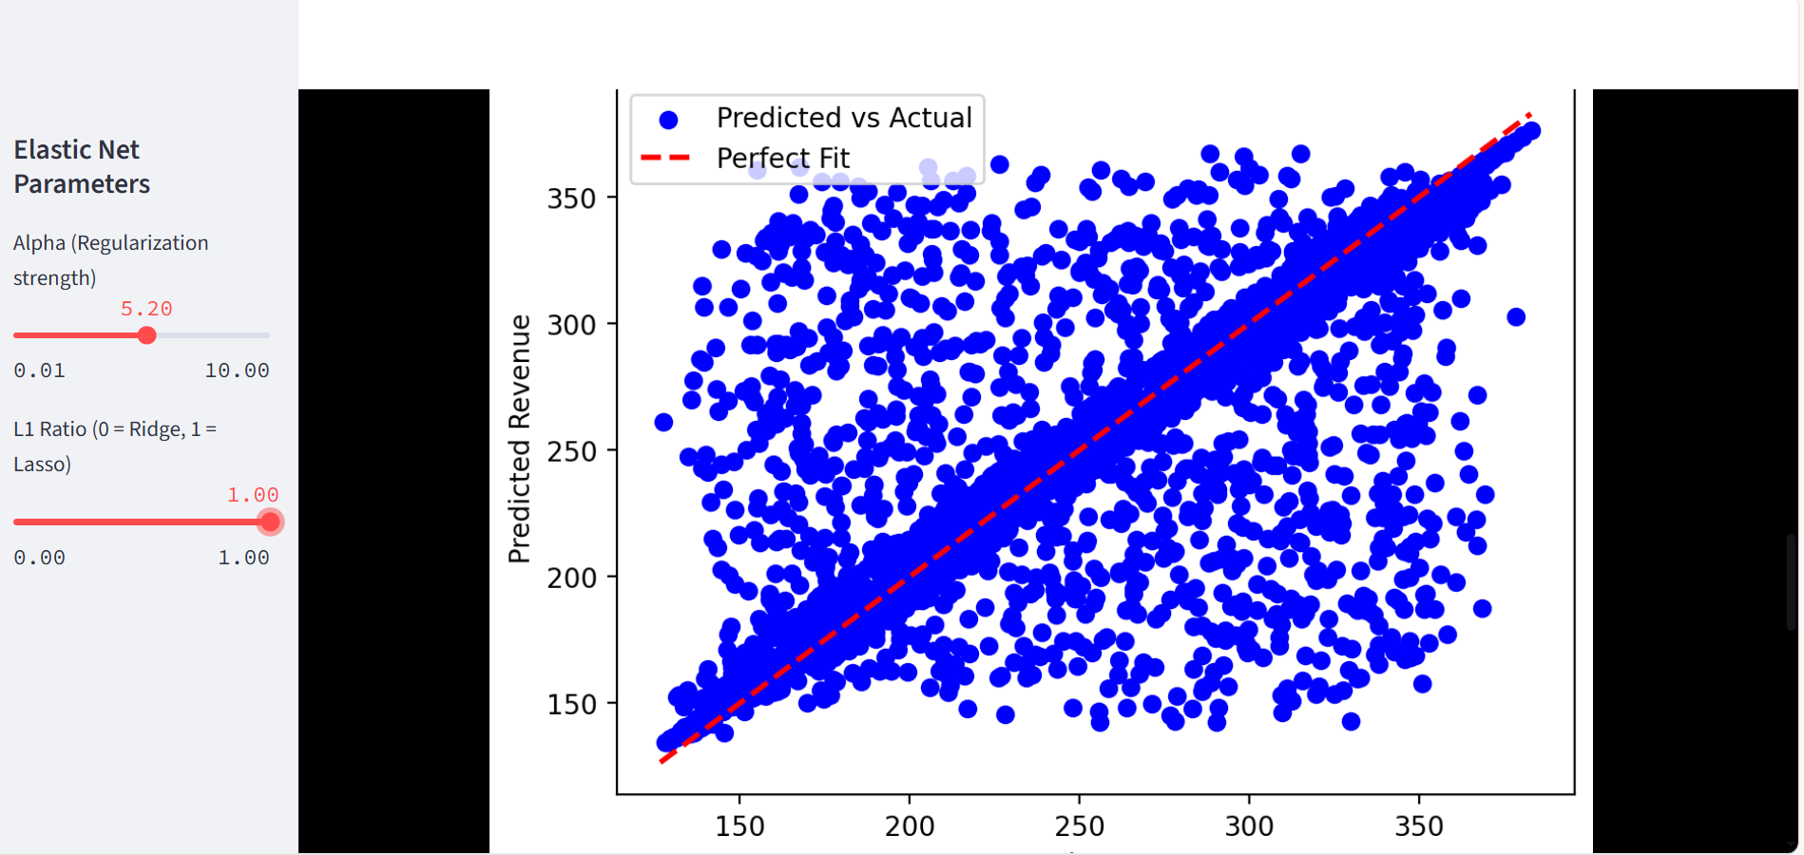
7.Streamlit Dashboard:
A Streamlit dashboard turns your model into an interactive tool that predicts revenue and shows results visually.

Slide 10
8.Business Insights:
S.no | Regression | MAE | RMSE | R2
01 | Linear Regression | 6.253 | 19.1907 | 90.395
02 | Ridge Regression | 6.253 | 19.190 | 90.3953
03 | Lasso Regression | 6.3283 | 19.1925 | 90.3934
04 | Multi Linear Regression | 6.269 | 19.206 | 90.379
05 | Elastic Net Regression | 6.269 | 19.206 | 90.379
06 | Random Forest Regression | 7.134 | 19.955 | 89.614
07 | Gradient Boosting Regression | 7.016 | 19.844 | 89.729
According to the table ,
MAE (Mean Absolute Error): Lower is better (6.253)
RMSE (Root Mean Squared Error): Lower is better (19.190)
R² (Coefficient of Determination): Higher is better (90.3953%)

Slide 11
Conclusion:
In this project, we developed and evaluated seven different regression models—including Linear, Ridge, Lasso, and others—to predict YouTube revenue analysis outcomes based on the available features. After thorough evaluation using the R² metric, the Ridge Regression model emerged as the most effective, achieving an R² score of 90%, indicating that it explains 90% of the variance in the target variable. This suggests that the Ridge model is highly capable of capturing the underlying patterns in the data. Feature analysis further highlighted which variables most influenced the predictions, providing actionable insights. While the model demonstrates strong predictive performance, future improvements could include incorporating additional relevant features or experimenting with ensemble methods to further enhance accuracy. Overall, the Ridge Regression model provides a robust tool for predicting YouTube revenue analysis, supporting data-driven decision-making and planning.

